Slide 1
NETWORK FLOW
MODULE 4

Slide 2
Flow Network is a directed graph that is used for modeling material Flow. It involves a source(S)and a sink(T)and several other nodes connected with each other
Network Flow is a subsection of graph theory related specifically to situations where something moves from one location to another.
An easily visualized example of network flow is piping system through which a quantity of water must pass.

Slide 3
A Network is a directed graph G
Edges represent pipes that carry flow
Each edge ltu,vgt has a maximum capacity cltu,vgt
A source node s in which flow arrives
A sink node t out which flow leaves

Slide 4
There are two different vertices;
  One is a source which produces material at some steady rate, and
  Another one is sink which consumes the content at the same constant speed.
  The flow of the material at any mark in the system is the rate at which the element moves.
Each node has an individual capacity which is the maximum limit of flow that edge can allow
Some real-life problems like the flow of liquids through pipes, the current through wires and delivery of goods can be modeled using flow networks.

Slide 5

Definition:
A Flow Network is a directed graph G = (V, E) such that
For each edge (u, v) ∈ E, we associate a nonnegative weight capacity c (u, v) ≥ 0.If (u, v) ∉ E, we assume that c (u, v) = 0.
There are two distinguishing points, the source s, and the sink t;
For every vertex v ∈ V, there is a path from s to t containing v.
Let G = (V, E) be a flow network. Let s be the source of the network, and let t be the sink. A flow in G is a real-valued function f: V x V→R such that the following properties hold:
Capacity Constraint: For all u, v ∈ V, we need f (u, v) ≤ c (u, v).
Skew Symmetry: For all u, v ∈ V, we need f (u, v) = - f (u, v).
Flow Conservation: For all u ∈ V-{s, t}, we need
Flow Networks and Flows

Slide 6
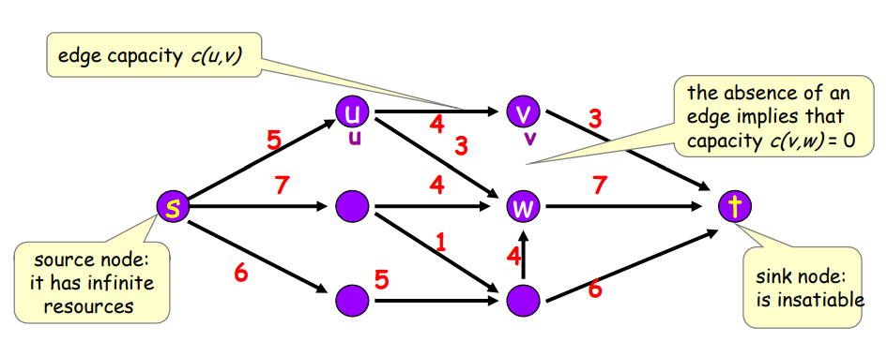

Slide 7
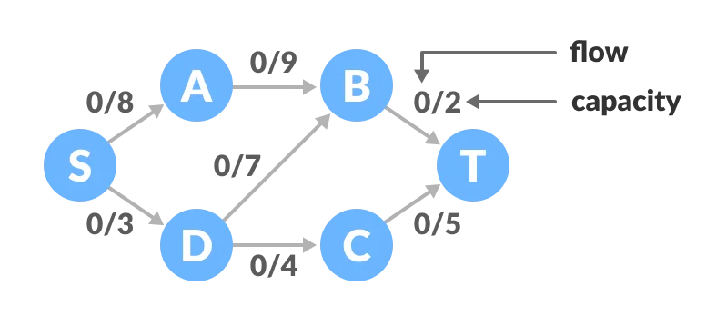

Slide 8
The Ford-Fulkerson algorithm
Ford-Fulkerson algorithm is a greedy approach for calculating the maximum possible flow in a network or a graph.
The Ford-Fulkerson algorithm is simply the following:
  while there exists an s → t path P of positive residual capacity (defined below), push the maximum possible flow along P.
  By the way, these paths P are called augmenting paths, because you use them to augment the existing flow.

Slide 9
Terminologies Used
Augmenting Path
It is the path available in a flow network.
Residual Graph
It represents the flow network that has additional possible flow.
Residual Capacity
It is the capacity of the edge after subtracting the flow from the maximum capacity.

Slide 10
How Ford-Fulkerson Algorithm works?
The algorithm follows:
Initialize the flow in all the edges to 0.
While there is an augmenting path between the source and the sink, add this path to the flow.
Update the residual graph.
We can also consider reverse-path if required because if we do not
consider them, we may never find a maximum flow.

Slide 11
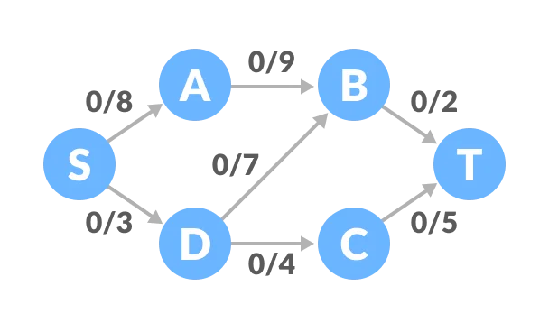
EXAMPLE

Slide 12
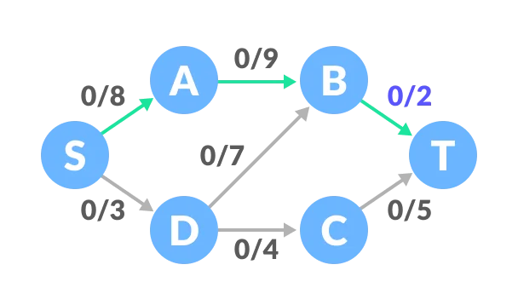
1. Select any arbitrary path from S to T. In this step, we have selected path S-A-B-T.

Slide 13
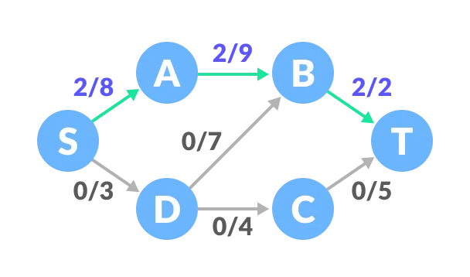
The minimum capacity among the three edges is 2 (B-T). Based on this, update the flow/capacity for each path.

Slide 14
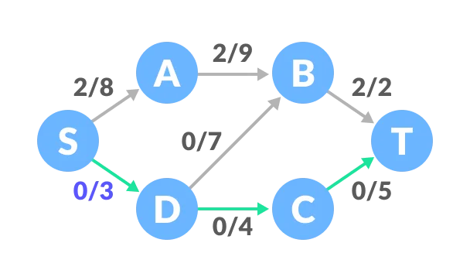
Select another path S-D-C-T. The minimum capacity among these edges is 3 (S-D).

Slide 15
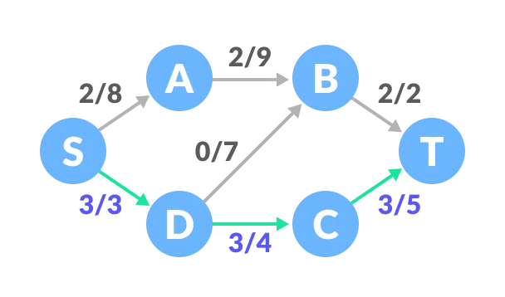
Update the capacities according to this.

Slide 16
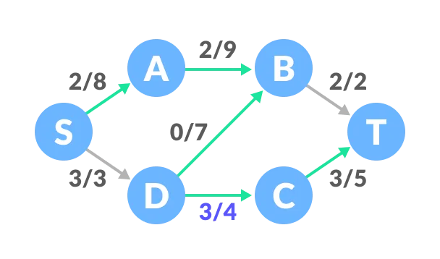
Now, let us consider the reverse-path B-D as well. Selecting path S-A-B-D-C-T.
The minimum residual capacity among the edges is 1 (D-C).

Slide 17
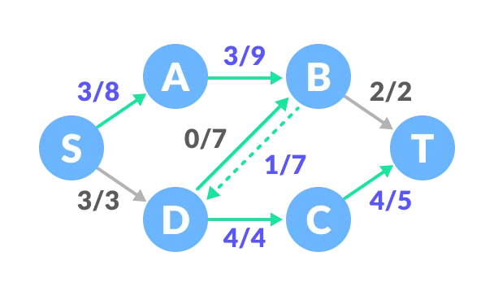
Updating the capacities.

Slide 18
The capacity for forward and reverse paths are considered separately.
Adding all the flows = 2 + 3 + 1 = 6, which is the maximum possible flow on the flow network.
Note that if the capacity for any edge is full, then that path cannot be used.

Slide 19
FORD-FULKERSON METHOD (G, s, t)
1. Initialize flow f to 0
2. while there exists an augmenting path p
3. do argument flow f along p
4. Return f
FORD-FULKERSON (G, s, t)
1. for each edge (u, v) ∈ E [G]
2. do f [u, v] ← 0
3. f [u, v] ← 0
4. while there exists a path p from s to t in the residual network Gf.
5. do cf (p)←min?{ Cf (u,v):(u,v)is on p}
6. for each edge (u, v) in p
7. do f [u, v] ← f [u, v] + cf (p)
8. f [u, v] ←-f[u,v]

Slide 20
BIPARTITE GRAPHS

Slide 21
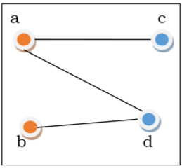
Bipartite Graph
If the vertex-set of a graph G can be split into two disjoint sets,
  V₁ and V₂ , in such a way that each edge in the graph joins a vertex in V₁ to a vertex in V₂ , and
  there are no edges in G that connect two vertices in V₁ or two vertices in V₂ , then the graph G is called a bipartite graph.

Slide 22
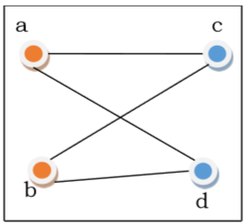
Complete Bipartite Graph
A complete bipartite graph is a bipartite graph in which each vertex in the first set is joined to every single vertex in the second set.
The complete bipartite graph is denoted by K_{x,y} where the graph G contains x vertices in the first set and y vertices in the second set.

Slide 23
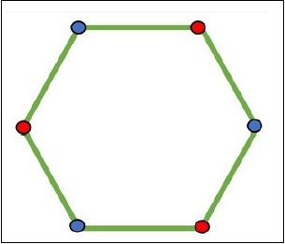
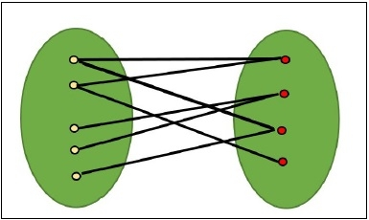
How to find if a graph is Bipartite?
Checking of a bipartite graph is possible by using the vertex coloring. When a vertex is in the same set, it has the same color, for another set, the color will change.

Slide 24






Bipartite Graphs
People
Tasks
Suppose we have a set of
people L and set of jobs R.
x
Each person can do only
Person u can do task x
some of the jobs.
u
Can model this as a bipartite graph →
L
R

Slide 25
Bipartite Matching
People
Tasks
A matching gives an
assignment of people to tasks.
a
1
Want to get as many tasks done as possible.
b
2
c
3
So, want a maximum
matching: one that contains as many edges as possible.
d
4
e
5
(This one is not maximum.)
L
R

Slide 26
Maximum Bipartite Matching
Maximum Bipartite Matching
Given a bipartite graph G = (A ∪ B, E ), find an S ⊆ A × B that is a matching and is as large as possible.
Notes:
We’re given A and B so we don’t have to find them.
S is a perfect matching if every vertex is matched.
Maximum is not the same as maximal: greedy will get to maximal.

Slide 27

Reduce
Given an instance of
Instance of Maximum Bipartite Matching
bipartite matching,
Create an instance of
network flow.
transform, aka reduce
Where the solution to the
network flow problem can easily be used to find the solution to the bipartite matching.
Instance of Network Flow

Slide 28



Reducing Bipartite Matching to Net Flow
People
Tasks
a
1
b
2
c
3
d
4
e
5
L
R

Slide 29
Reducing Bipartite Matching to Net Flow
People
Tasks
a
1
b
2
c
3
d
4
e
5
L
R

Slide 30
Reducing Bipartite Matching to Net Flow
People
Tasks
a
1
b
2
t
s
c
3
d
4
e
5
L
R

Slide 31
Reducing Bipartite Matching to Net Flow
People
Tasks
a
1
1
1
1
1
1
b
2
1
1
1
1
t
s
1
c
1
3
1
1
1
1
d
1
4
1
1
e
1
5
L
R

Slide 32
Using Net Flow to Solve Bipartite Matching
To Recap:
Given bipartite graph G = (A ∪ B, E ), direct the edges from A to B.
Add new vertices s and t.
Add an edge from s to every vertex in A.
Add an edge from every vertex in B to t.
Make all the capacities 1.
Solve maximum network flow problem on this new graph G^{j}.
The edges used in the maximum network flow will correspond to the largest possible matching!

